Slide 2
McStas and how-to generate event data for Mantid and scipp
Torben

Slide 3
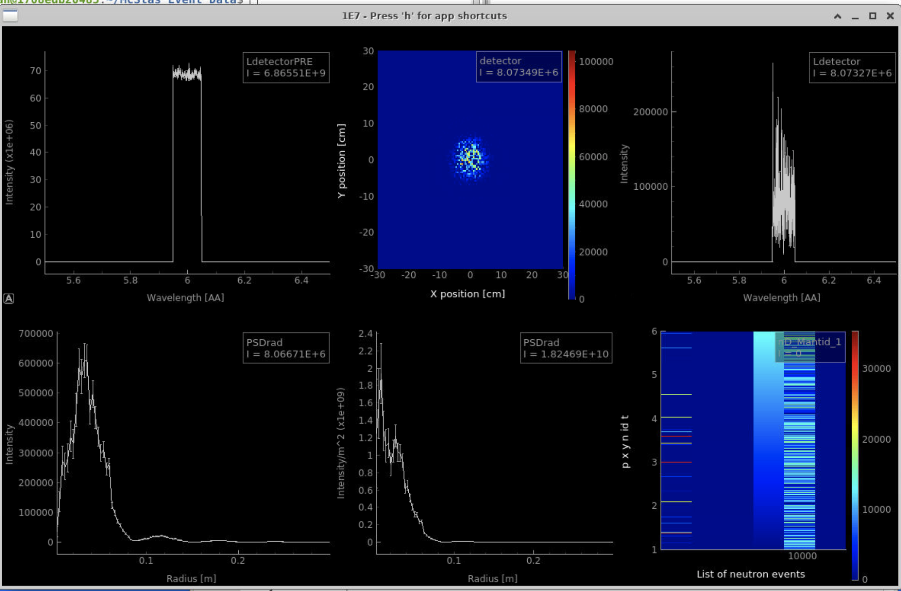
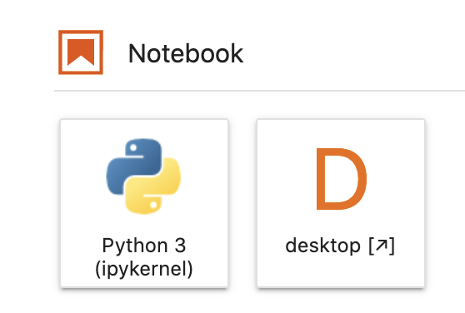
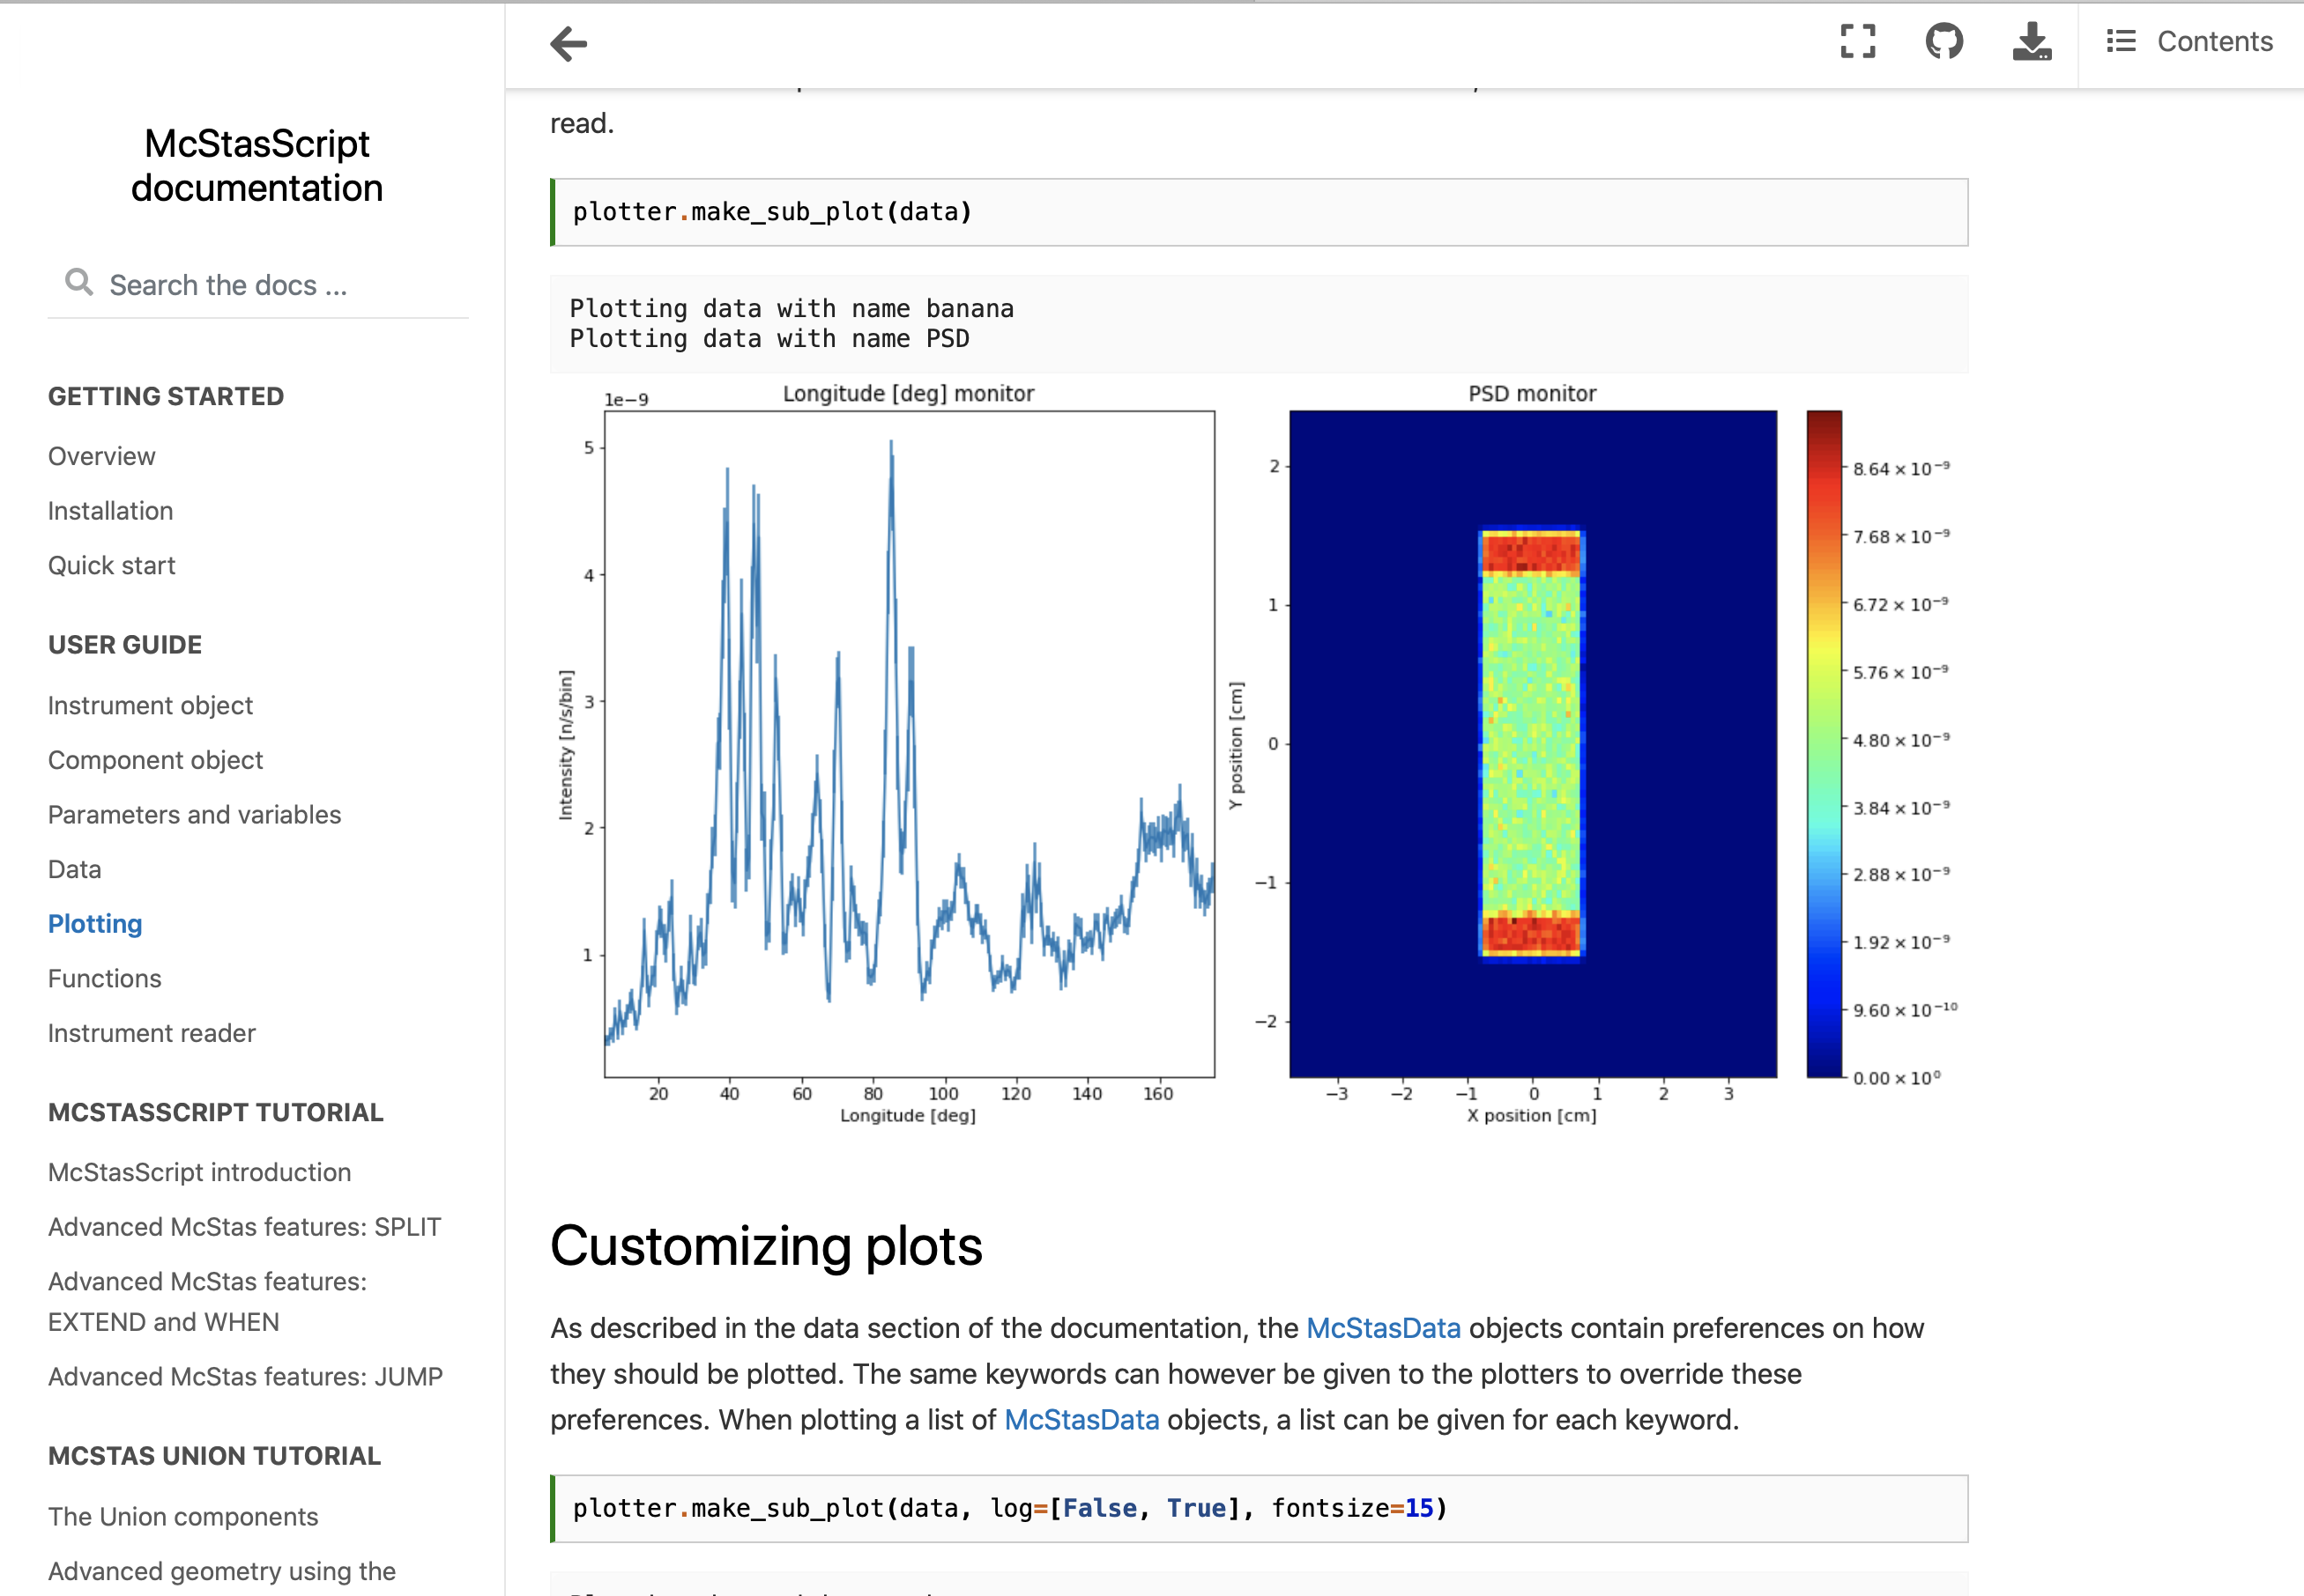
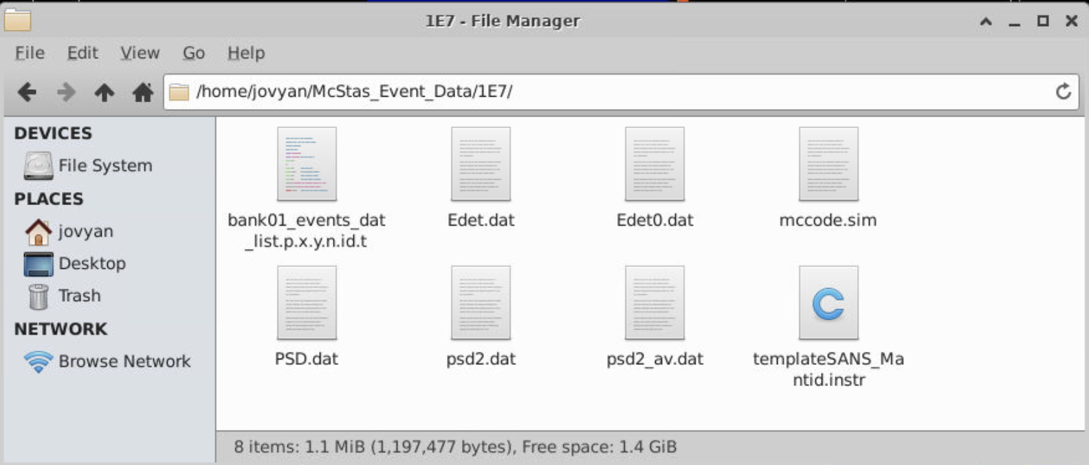
McStas and McStasScript
Histogram data / binned data / ascii data
mcgui

Slide 4


McStas event data and The NeXus file
Process McStas event data as you would do with recorded data from a beamline
NeXus file
Mantid
https://www.nexusformat.org
The McStas Nexus file must contain:
Event data, i.e. each neutron has a pixel id and a time stamp
An IDF McStas monitor_nD gives pixle id & time for each event
mcdisplay can auto-generate an IDF

Slide 5
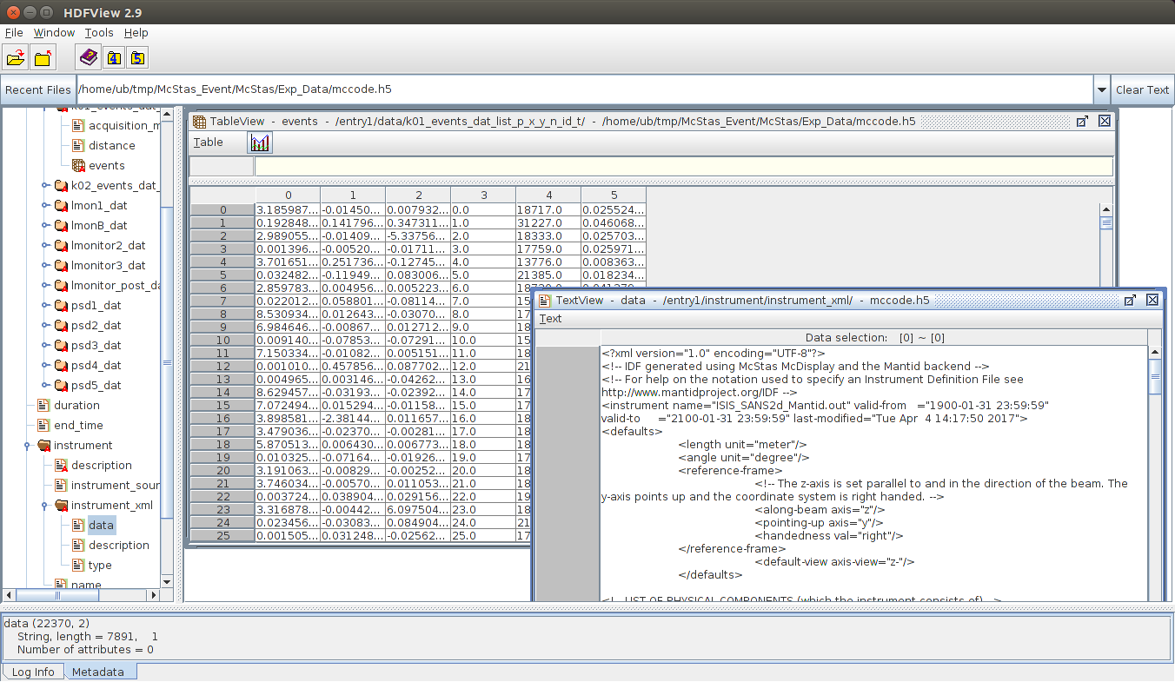
McStas NeXus file
Mantid/scipp compatible

Slide 6
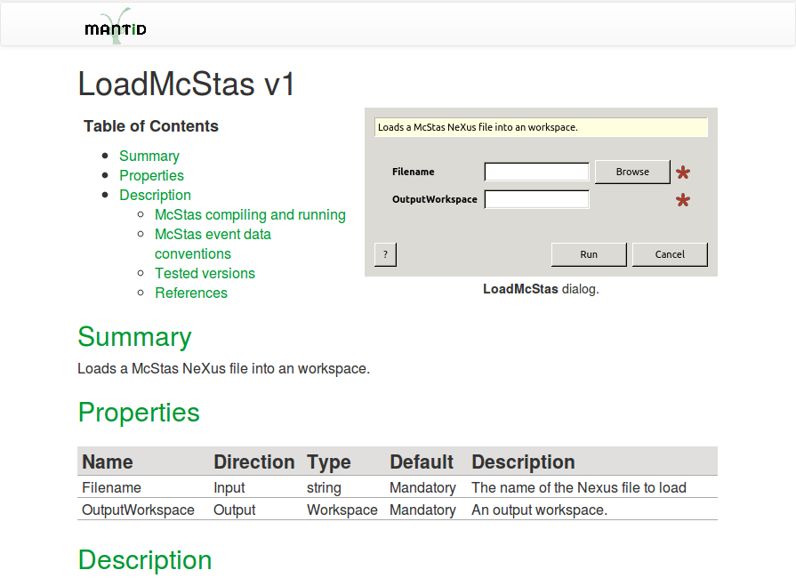
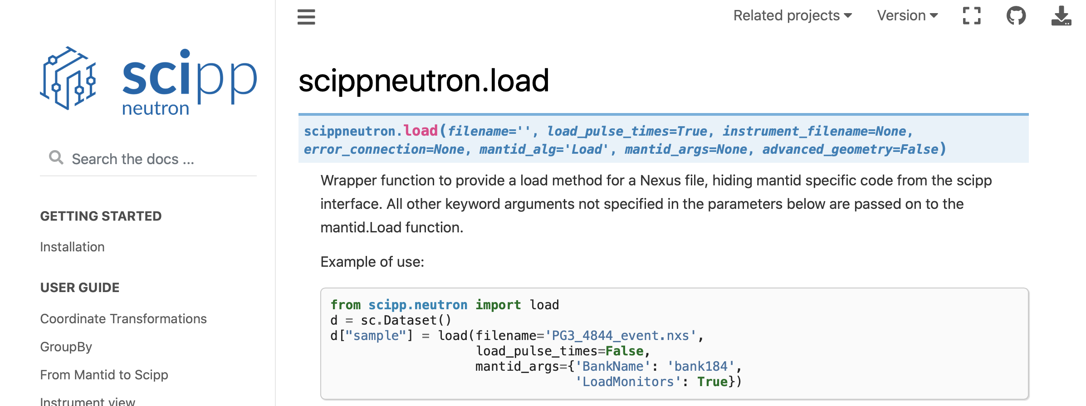
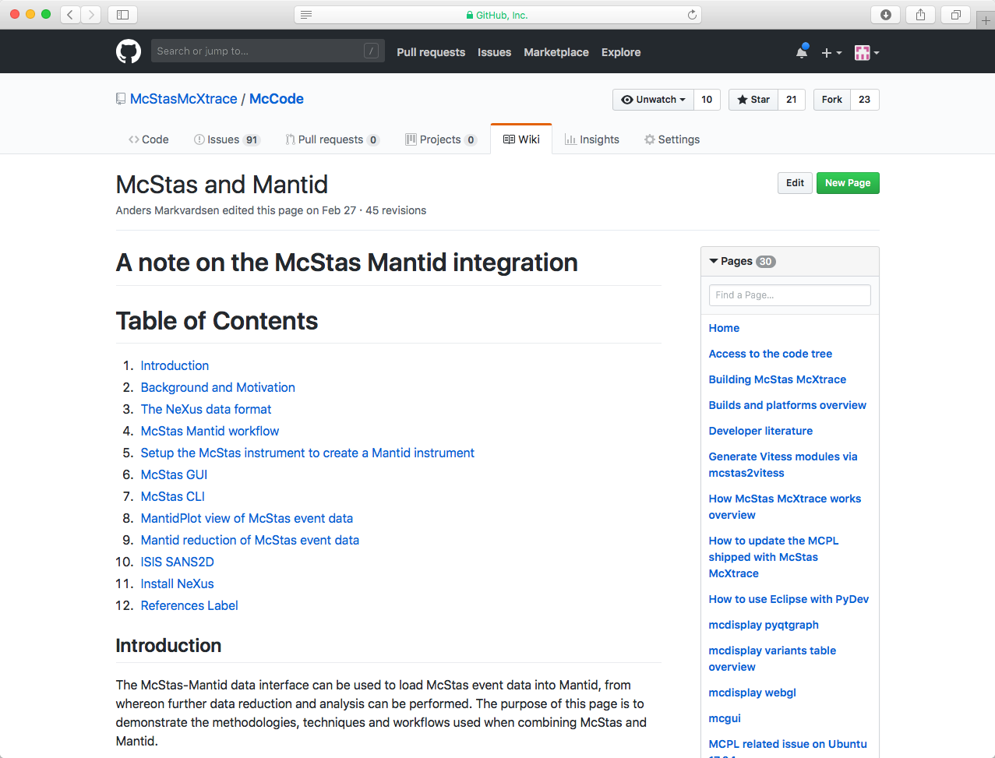
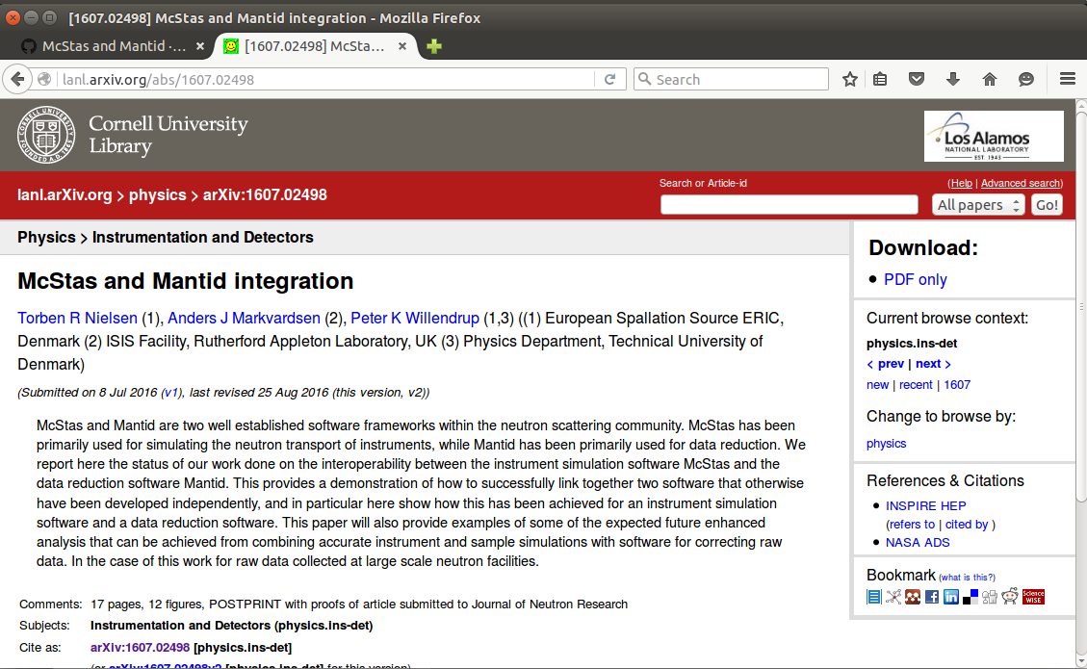
How to use: Online documentation
Github McStas wiki pages
Archive - lanl.arXiv.org
Docs in Mantid/scipp
6

Slide 7
IDF xml data, TOF and pixel ID’s
Mantid’s IDF stores geometry information used in TOF analysis
This implies parsing information about:
where the neutron source is located,
where the sample is located,
where each individual detector pixel is located.

Slide 8
McStas event KEYWORDS
McStas instrument file name and the McStas defined name of the instrument must be the same:
E.g. templateSANS_Mantid.instr and “DEFINE INSTRUMENT templateSANS_Mantid(…. )”
In the McStas instrument file the source must be named “sourceMantid”
E.g. "COMPONENT sourceMantid = Source_simple(…. )"
In the McStas instrument file the sample must be named “sampleMantid”
E.g. "COMPONENT sampleMantid = Sans_spheres(…. )"
In the McStas instrument file the event monitors must be named “nD_Mantid_#”
E.g. "COMPONENT nD_Mantid_1 = Monitor_nD(…. )"

Slide 9
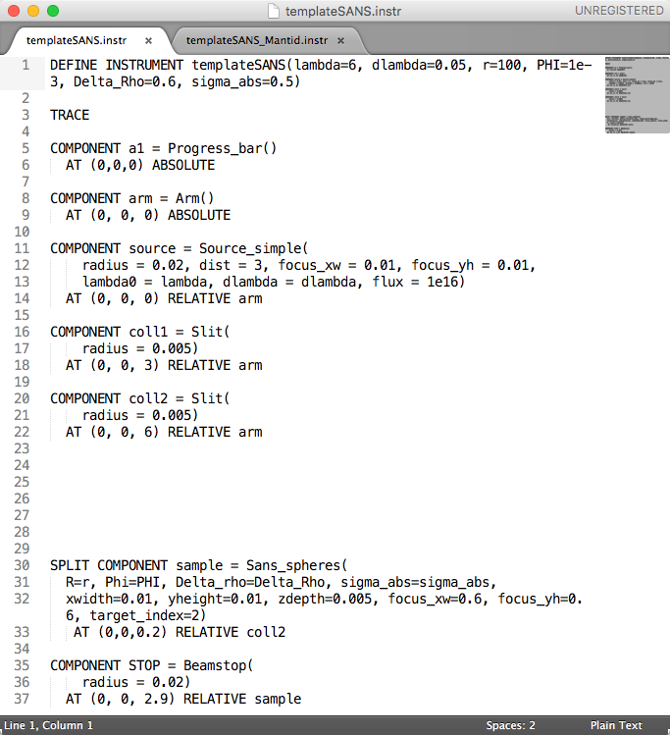
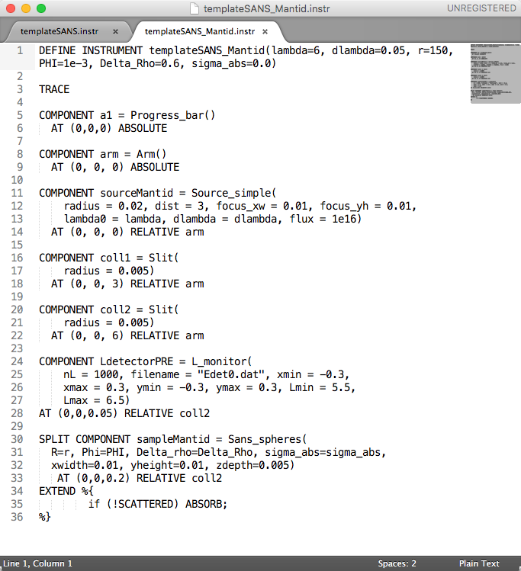
templateSANS.inst vs templateSANS_Mantid.inst

Slide 10
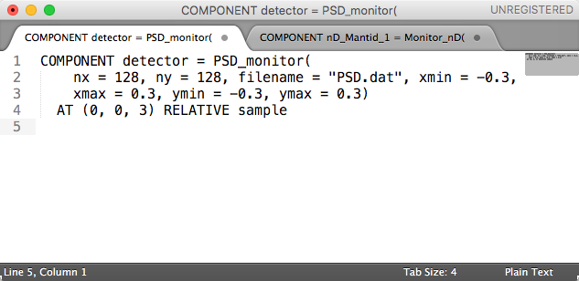
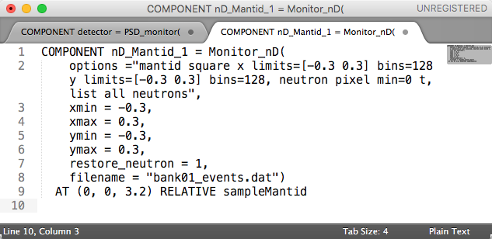
templateSANS.inst vs templateSANS_Mantid.inst

Slide 11
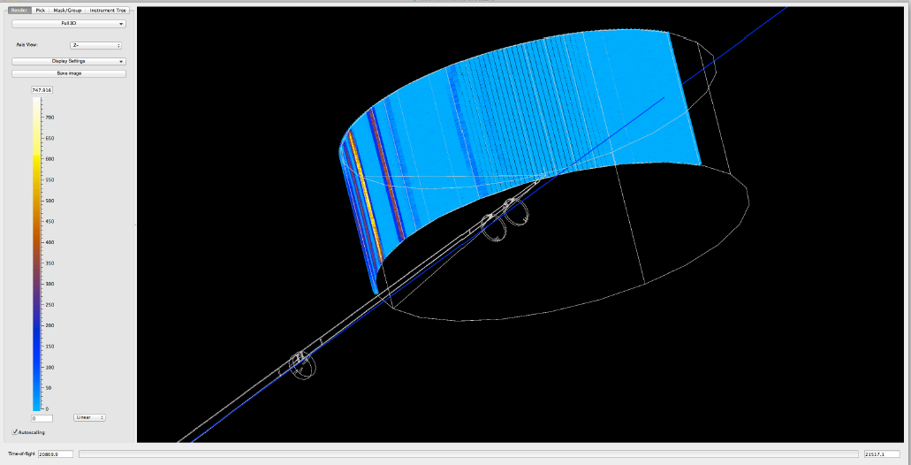
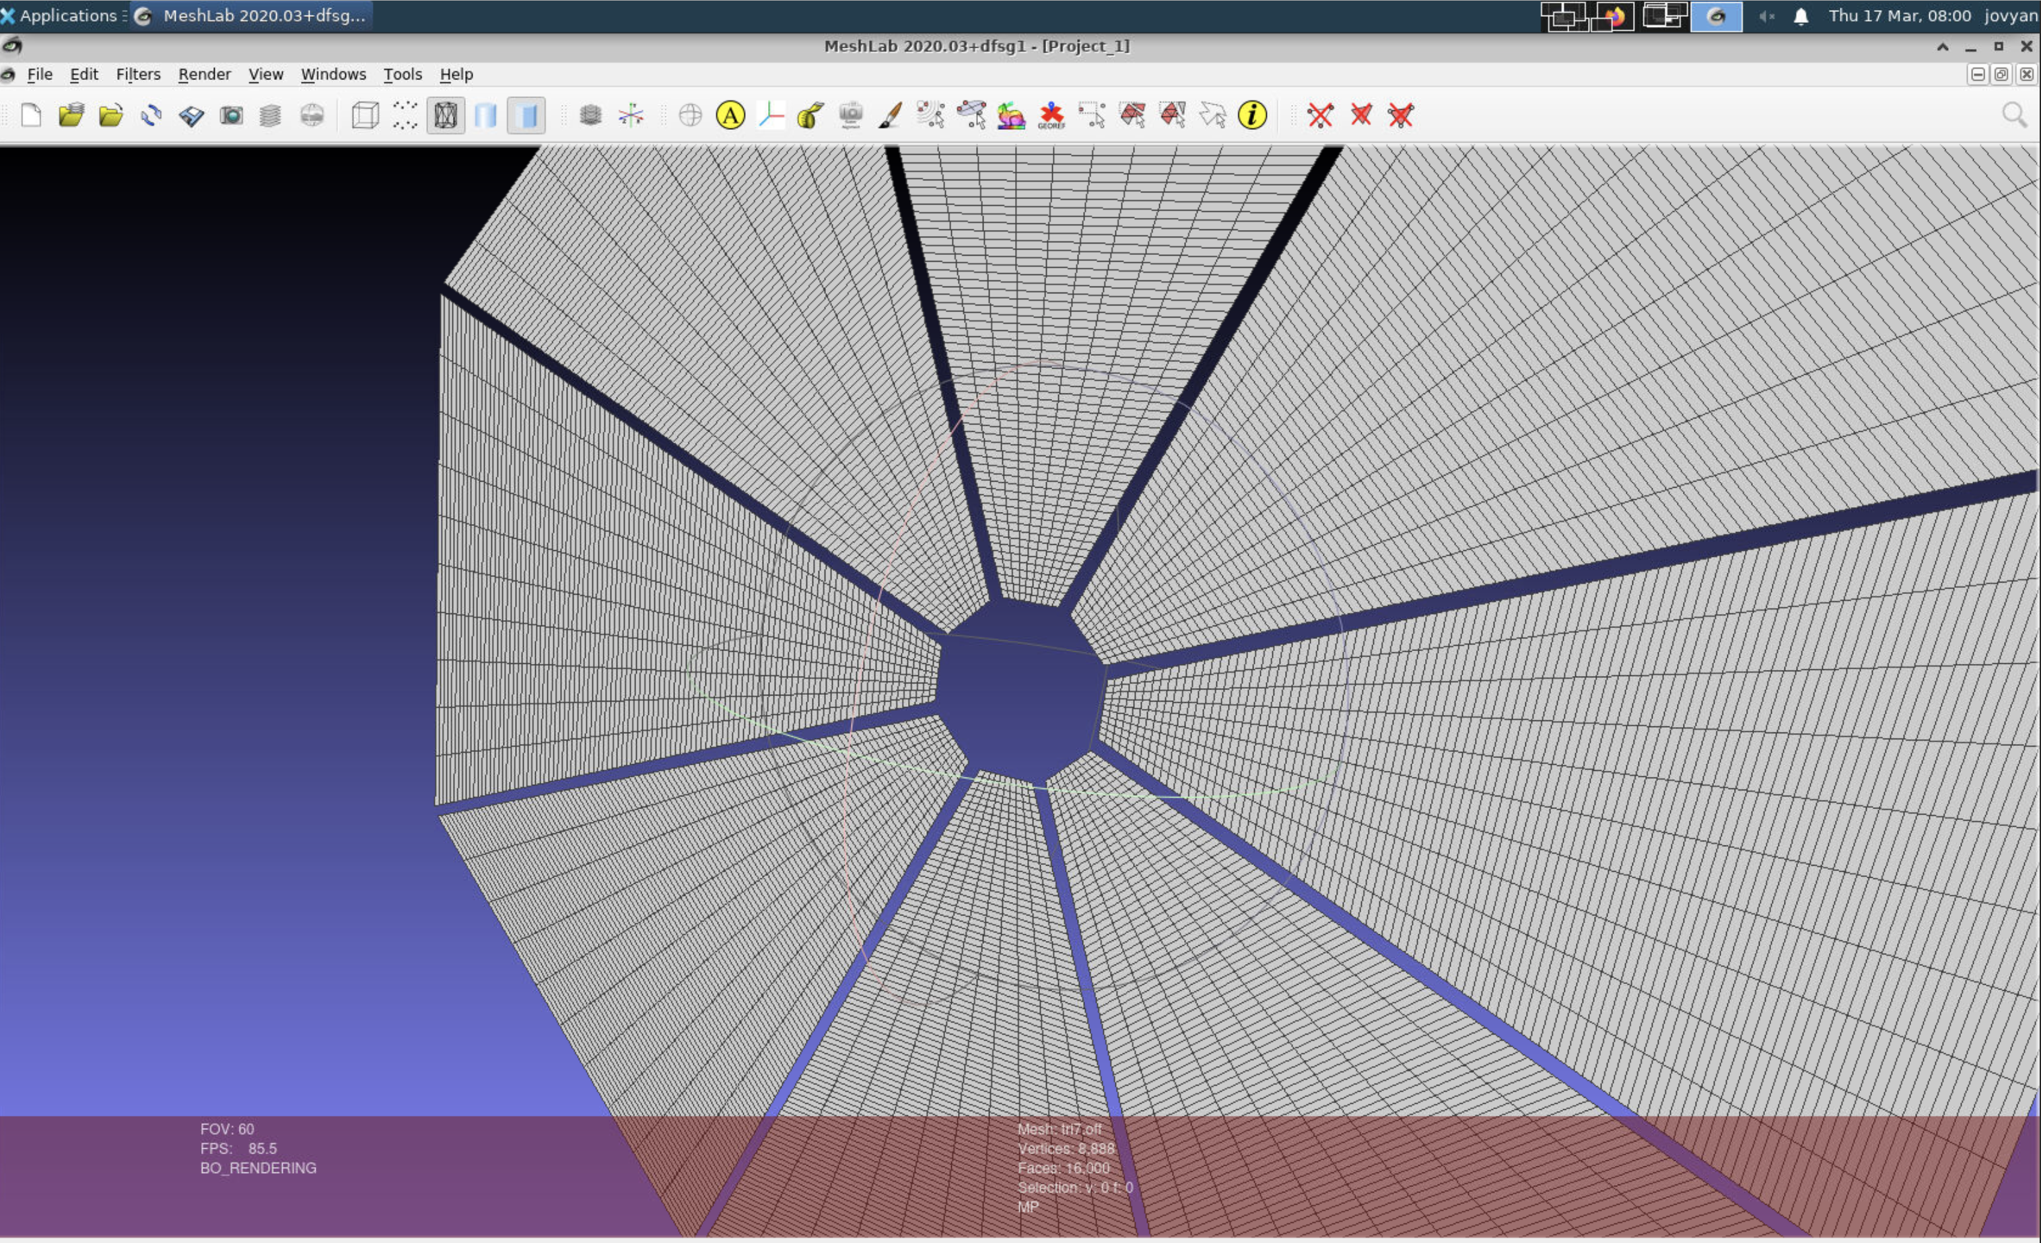
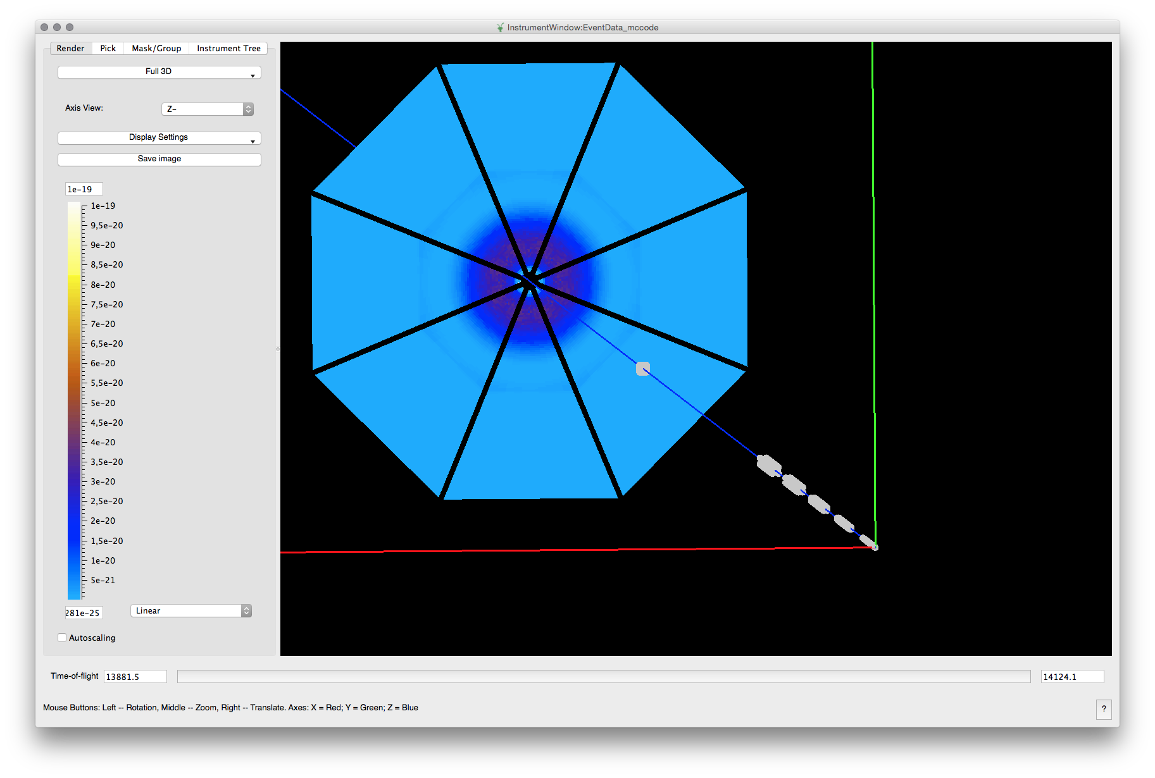
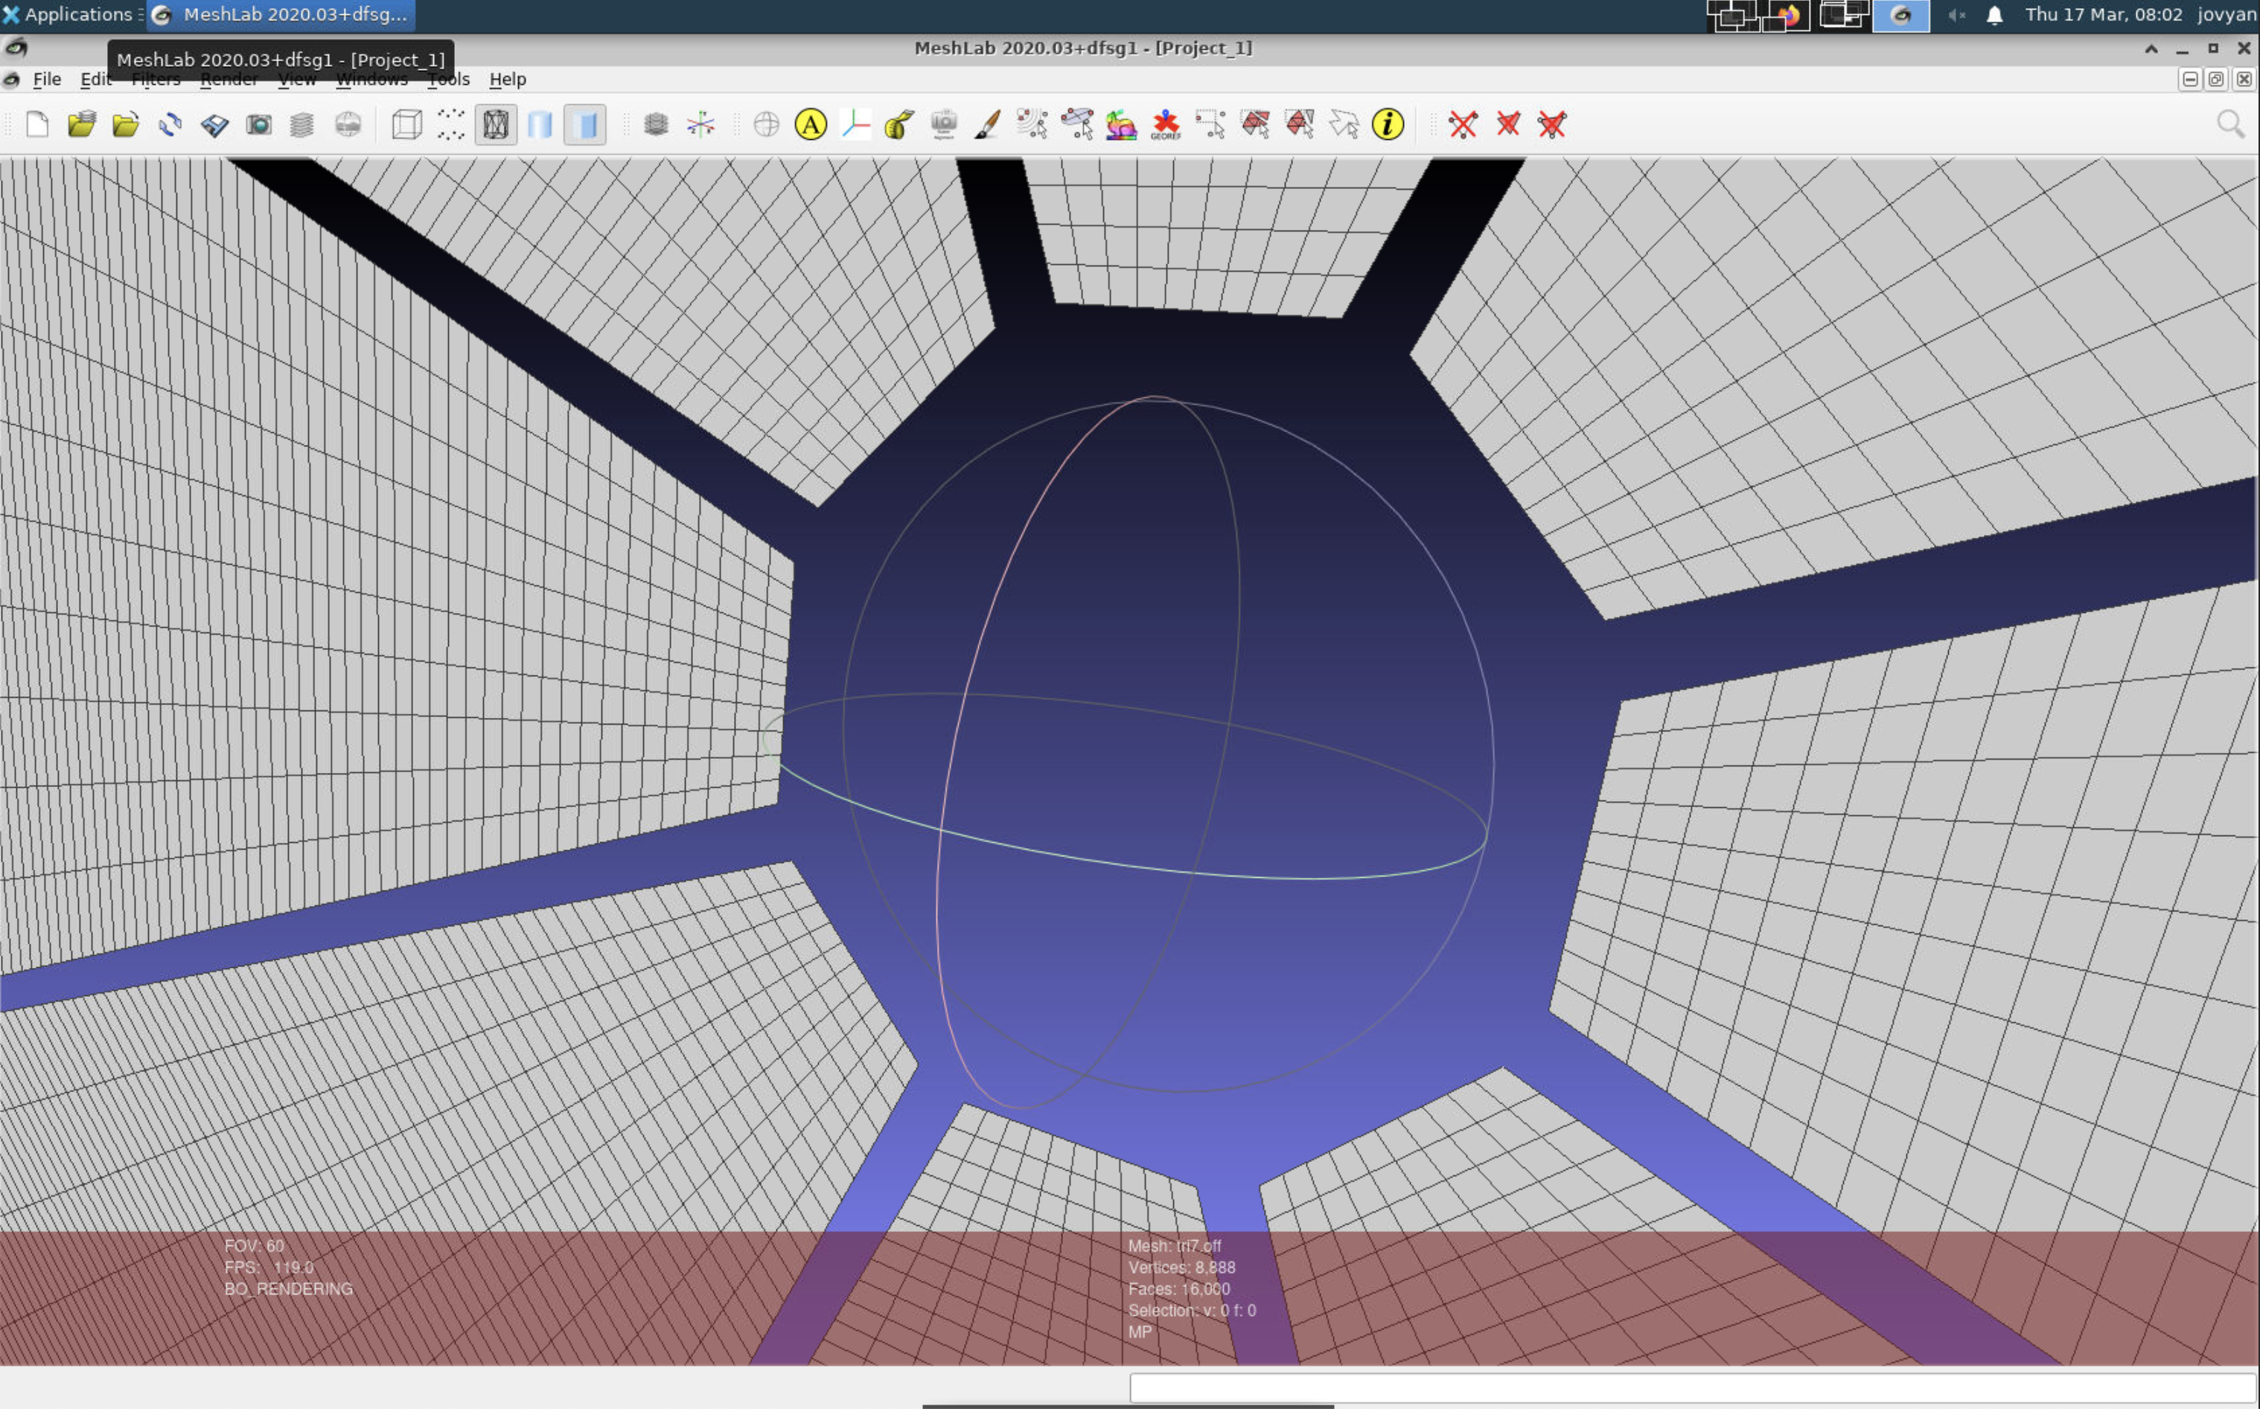
Examples of detectors: IN5 (ILL) and LoKI (ESS)
A banana shaped monitor
Off file geometry

Slide 12
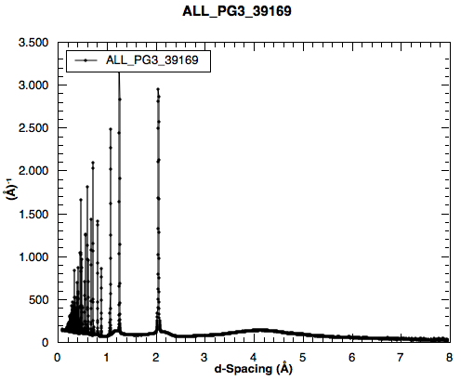
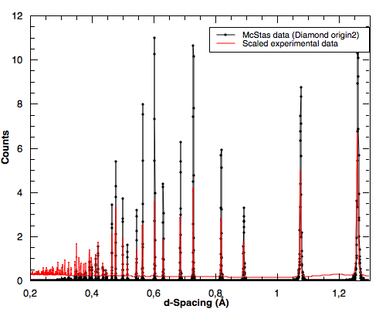
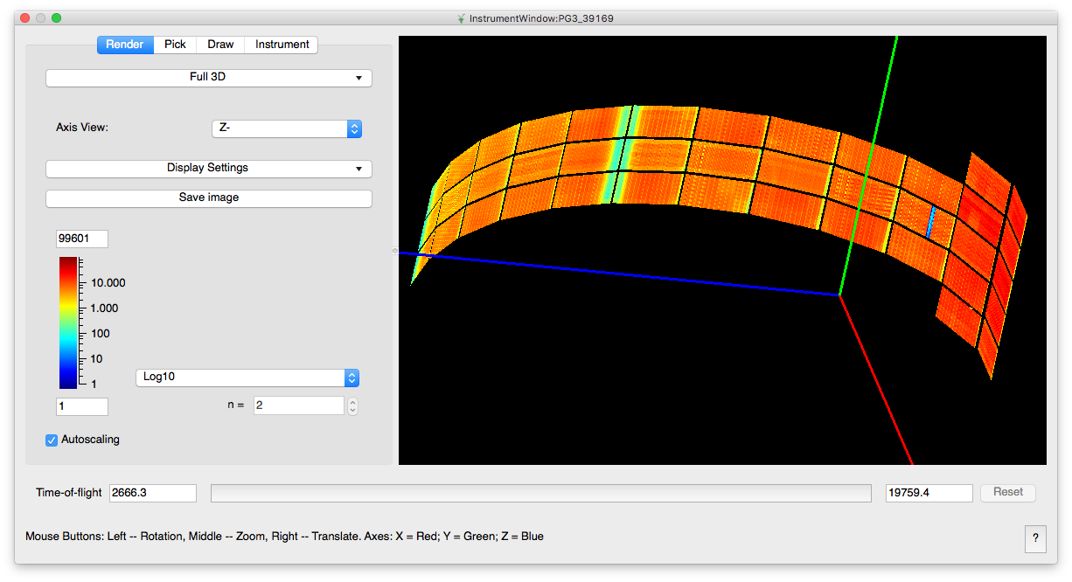
McStas and experimental data: POWGEN
By CelineD @ ESS + SNS collaboration

Slide 13
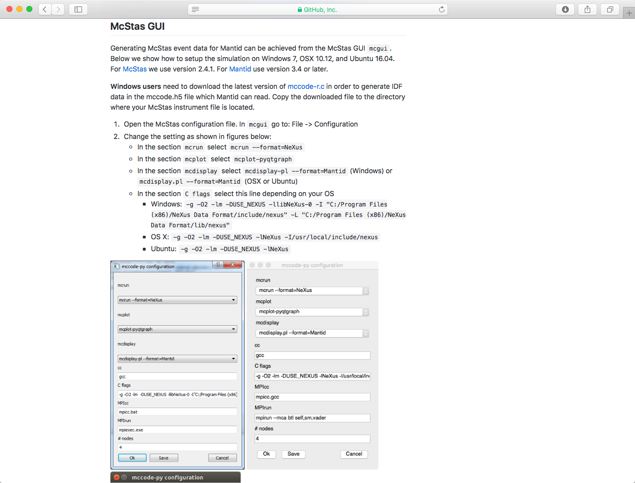
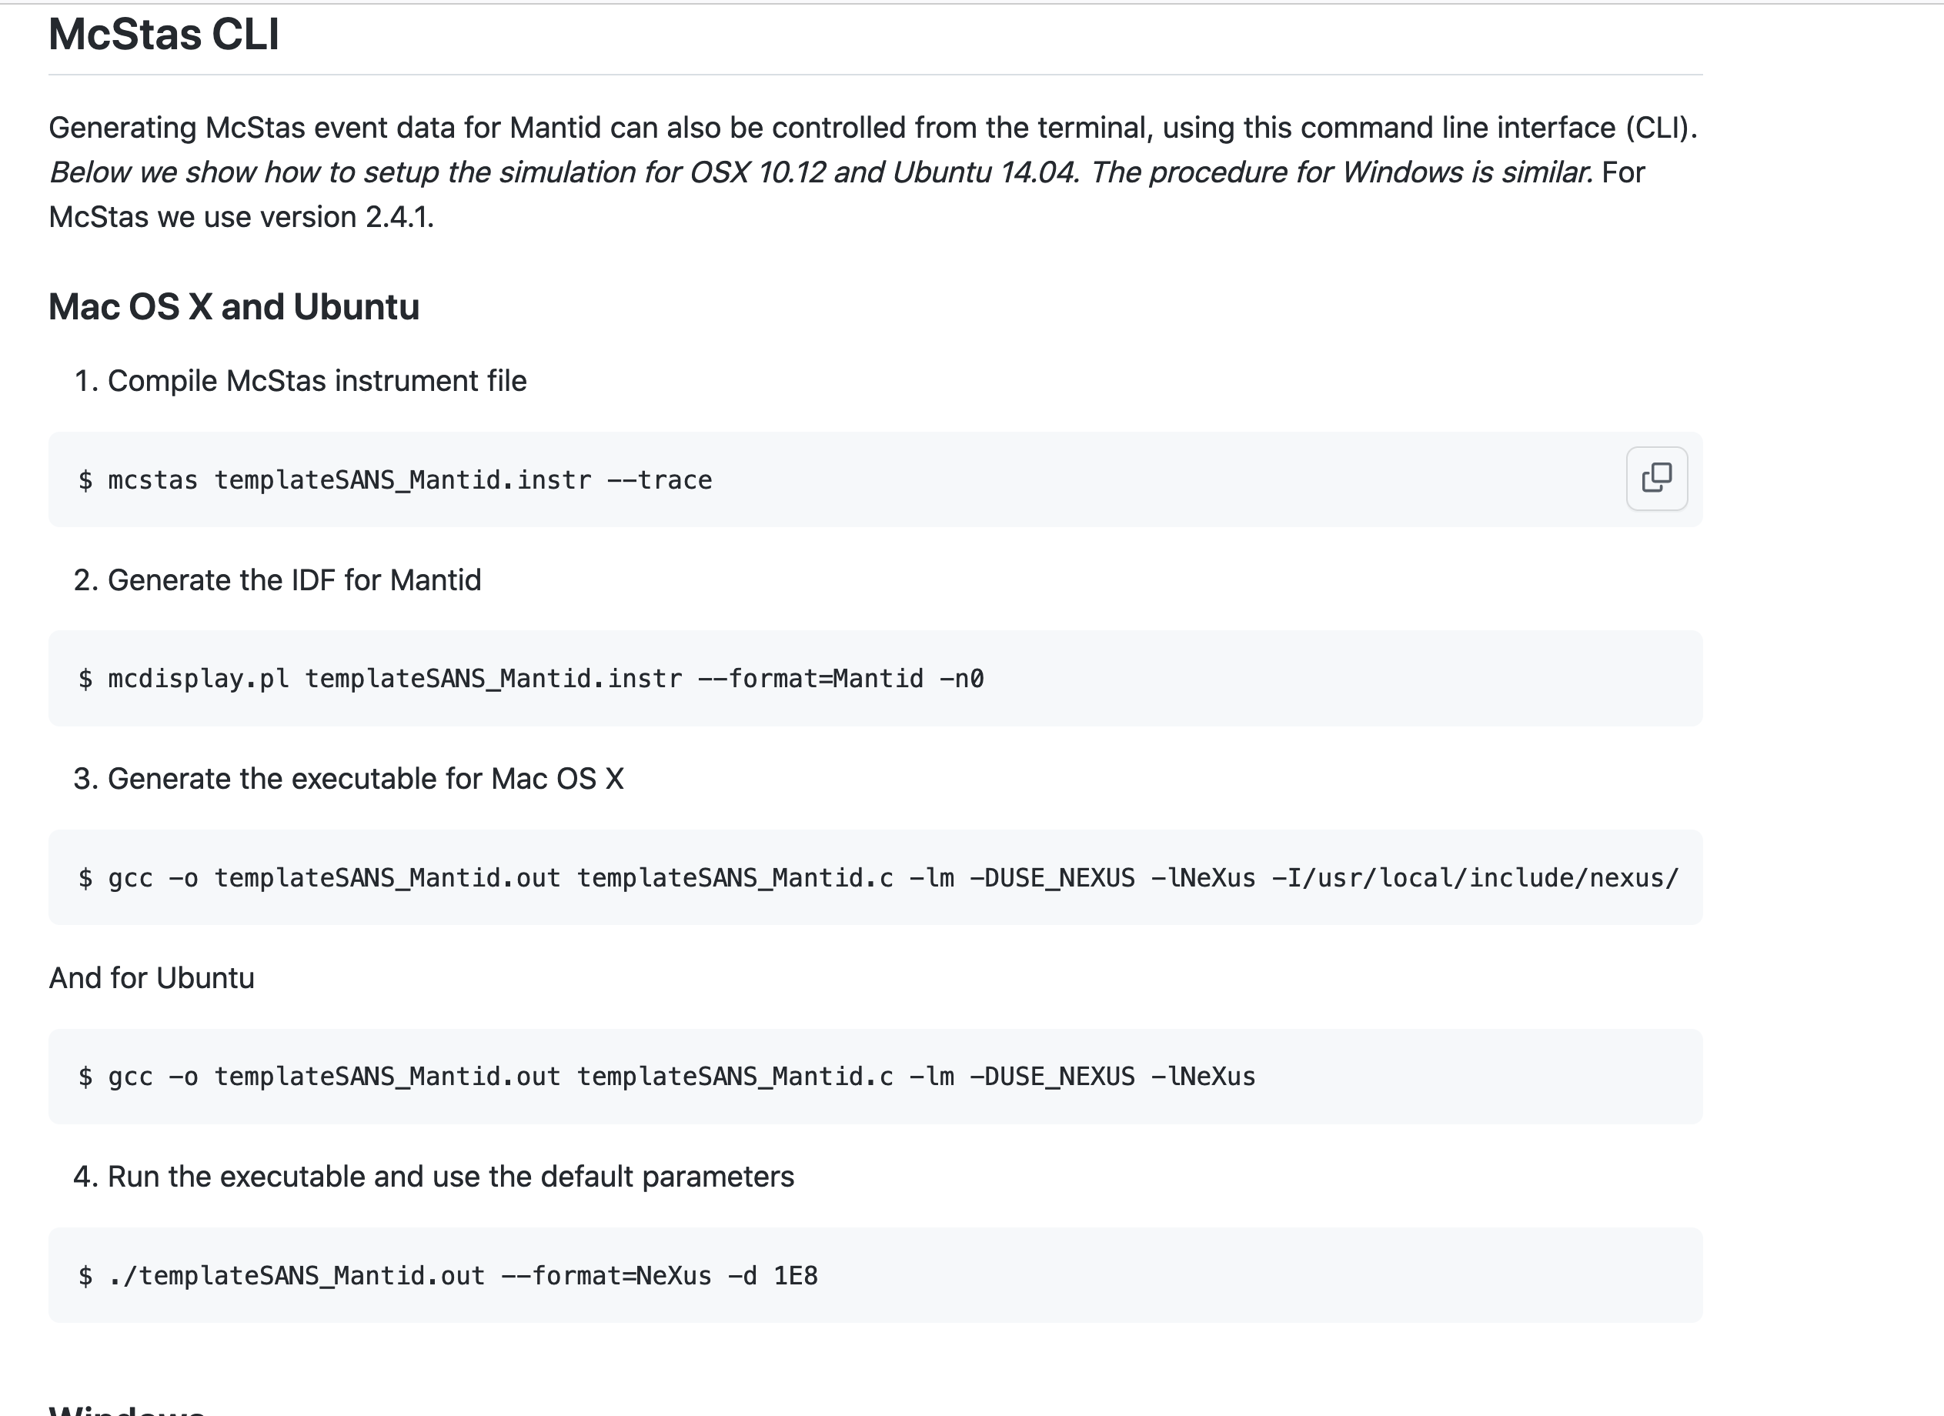
How to use: How to run simulation
Github wiki pages

Slide 14
How to use CLI: Generate the IDF
How-to generate McStas event data for Mantid/scipp
Step 1. Generate c file:
mcstas templateSANS_Mantid.instr --trace
Step 2. Generate IDF:
mcdisplay-mantid.pl templateSANS_Mantid.instr -n0
A new xml IDF file is then generated on disk

Slide 15
How to use CLI: Make NeXus file for Mantid/scipp
How-to generate McStas event data for Mantid/scipp
Step 1. Compile c code:
gcc -o templateSANS_Mantid.out templateSANS_Mantid.c -DUSE_NEXUS –lNeXus –lm -I/usr/include/nexus
Step 2. Run simulation:
templateSANS_Mantid.out --format=Nexus
Now IDF is embedded in the NeXus file to be read by Mantid/scipp

Slide 17
Demo
Let’s try to do a test . . . . . . .

Slide 19
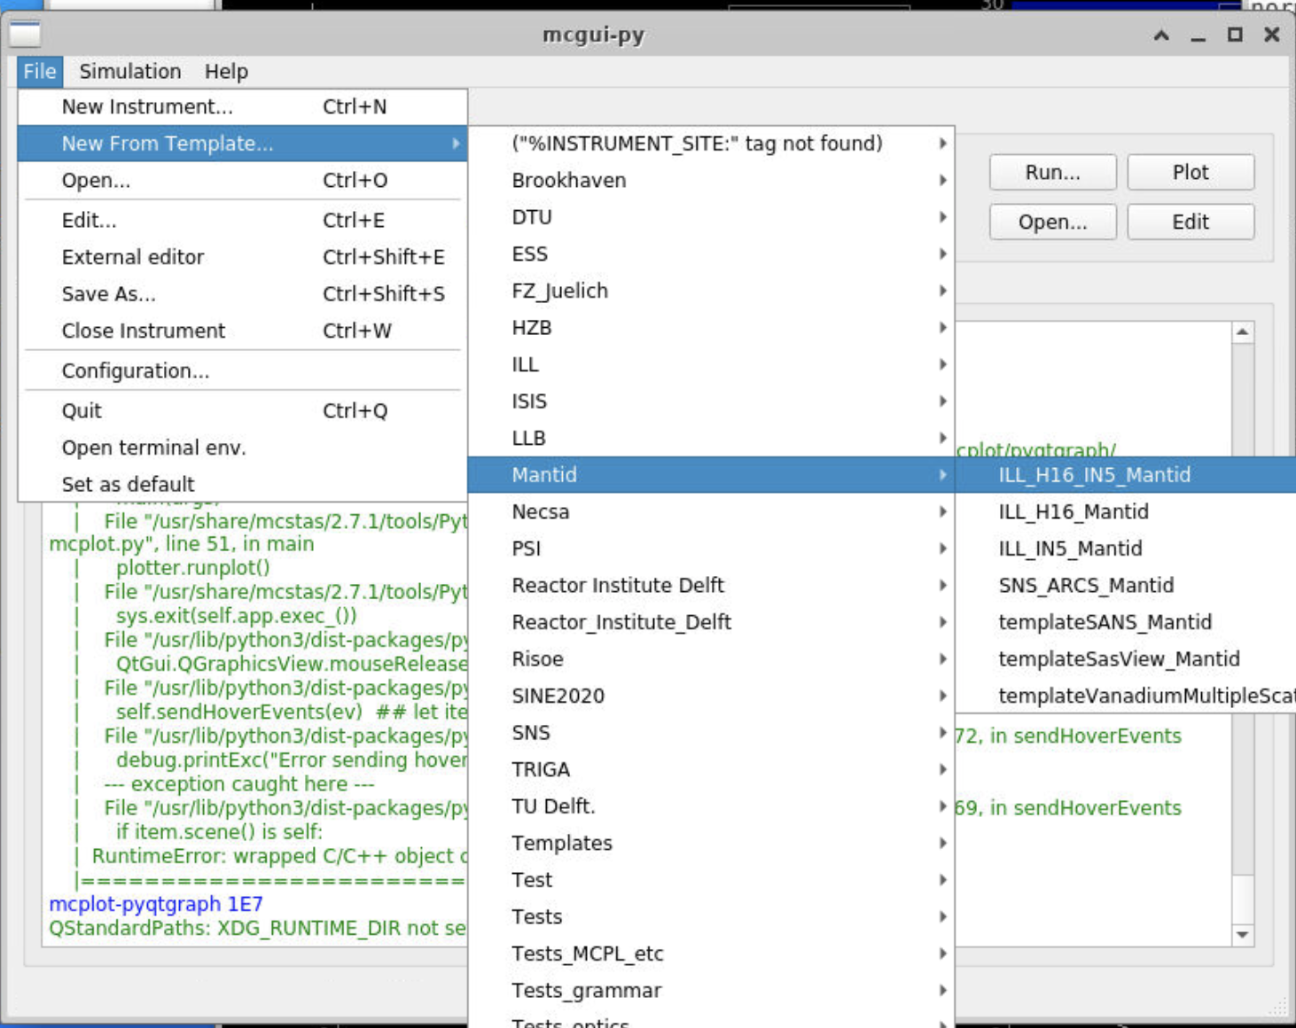
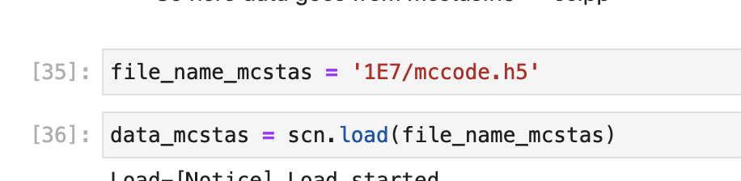
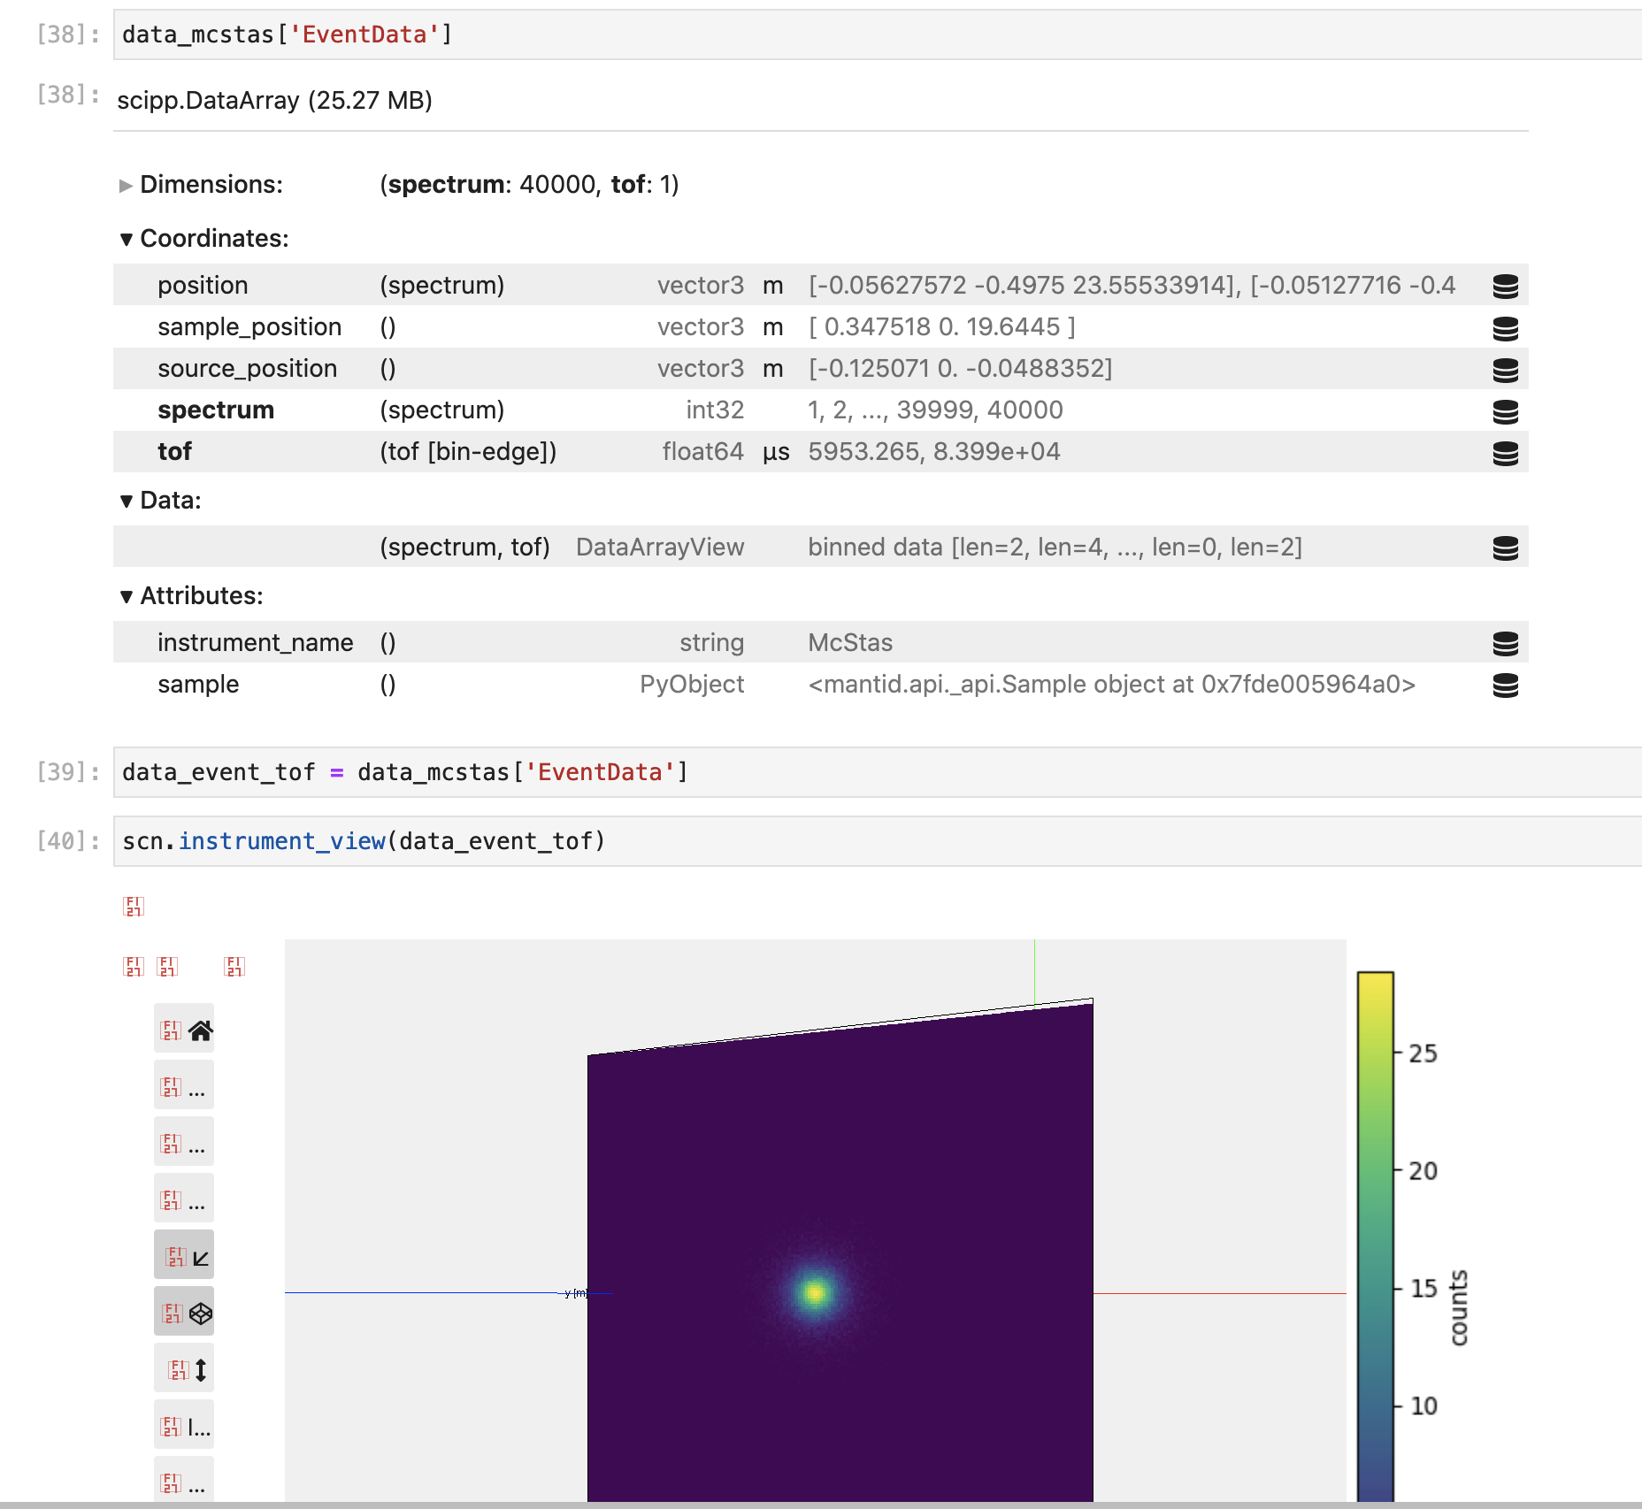
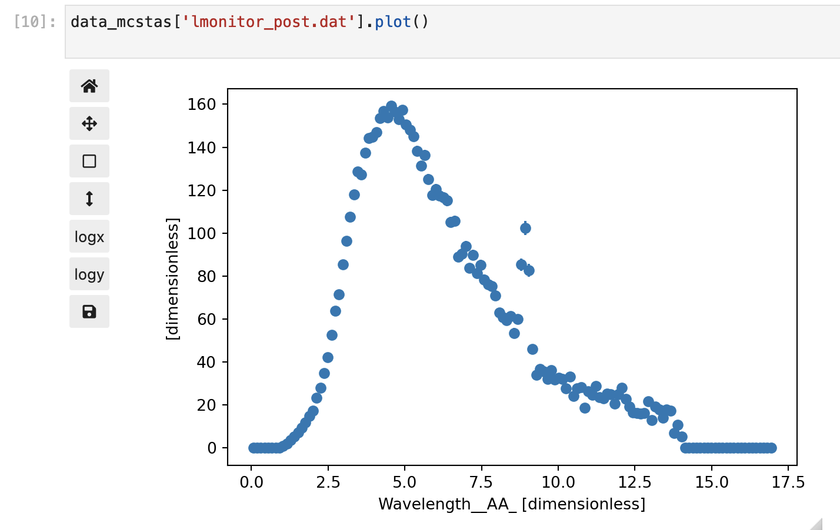
Exercise
Compile a Mantid/scipp instrument and generate event data
* choose your instrument
* compile and run (use 2.7.1)
* load into scipp
* view instrument
* plot monitors (in scipp)

Slide 20
Finish presentation

